Slide 1




WEB PAGES DESIGN
Introduction to JavaScript: Functions,
DOM, Forms, and Event Handlers
Part (2)
Lecturer: Dr. Atheer Akram AbdulRazzaq
Lecture 11.
Class 2.
Time: 10:30 - 12:30
Department: Businesses Information Technology (BIT)

Slide 2
Outline
Outline
Text Control
Email Address Generator Web Page
Accessing a Form’s Control Values
reset and focus Methods
Comments and Coding Conventions
Event-Handler Attributes
onchange, onmouseover, onmouseout
Using noscript to Accommodate Disabled JavaScript
Summary

Slide 3

Outline
Text Control
Here’s a template for the text control’s syntax:
<input type="text" id="text-box-identifier"
placeholder="user-entry-description"
size="box-width" maxlength="maximum-typed-characters">
As you can see, and as you might recall from our description of the button control, input element is a void element, so there’s just one tag and no end tag.
The preceding text control template does not include all the attributes for a text control—just the more important ones.
let’s first look at an example text control code fragment:
<input type="text" id="ssn"
placeholder="#########" size="9" maxlength="9">
The text control is for storing a Social Security number, so the id attribute’s ssn value is an abbreviation for Social Security number. What’s the purpose of the nine #’s for the placeholder attribute? Social Security numbers have nine digits, so the nine #’s implicitly tell the user to enter nine digits with no hyphens.
Attributes
Here are the text control attributes we’ll talk about in this subsection:

Slide 4
Outline
Text Control (continue…)
Attributes (continue…)
The type attribute specifies the type of control. For a text control, use type="text". The default value for the type attribute is text, so if you omit the type attribute, you’ll get a text control. For the self-documentation purposes, we recommend that you always include type="text" for your text controls.
The id attribute’s value serves as an identifier for the text control, so it can be accessed with JavaScript.
The placeholder attribute provides a word or a short description that helps the user to know what to enter into the text control. When the page loads, the browser puts the placeholder’s value in the text control.
The size attribute specifies the text control’s width, where the width value is an integer that approximates number of average-size characters that can fit in box.
The maxlength attribute specifies the maximum number of characters that can be entered in the box.
The next four attributes are popular:-
The value attribute specifies an initial value for the text control. The value attribute’s value is treated as user input.
The autofocus attribute specifies that after the page has loaded, the browser engine positions the cursor in the text control.
The disabled attribute specifies that the text control cannot receive the focus, and, therefore, the user cannot copy or edit the text control’s value.
The readonly attribute specifies that the user can highlight the control’s value and copy it, but the user cannot edit it.

Slide 5
Outline
Email Address Generator Web Page
We examine a web page that uses text controls for a person’s first and last names. In example 2A and 2B., we can see what happens on that web page when the user clicks the Generate Email button.
The underlying JavaScript code retrieves the text controls’ user-entered values and displays an email address that’s built with those values.
let’s start with the body container, which you can see in example 2A., Note the form container and the h3 element above the form. It would be legal to move the h3 element inside the form, but we recommend not doing so. It’s good to keep the form clean, with just control elements and their labels inside it.
Note: the two text controls with size="15". So are the user entries limited to 15 characters each? No. The boxes are 15 characters wide, but the user can enter as many characters as desired.
Note: the first-name text control’s autofocus attribute. That causes the browser to load the web page with the cursor in that text control.
Note: the p element below form. It’s a placeholder for generated email address.
When the user clicks the button, the JavaScript engine calls the generateEmail function, which assigns the generated email address to the empty area between the p element’s start and end tags.

Slide 6
Email Address Generator Web Page (continue…)
Outline
Example 2A., (continue…)
Example 2A.,
<body>
<h3>
Enter your first and last names and then click the button.
</h3>
<form>
First Name:
<input type="text" id="first" size="15" autofocus>
<br>
Last Name:
<input type="text" id="last" size="15">
<br><br>
<input type="button" value="Generate Email"
onclick="generateEmail(this.form);">
</form>
<p id="email"></p>
</body>
</html>
Note the this.form argument in the button event handler’s generateEmail function call. In generateEmail function, we’ll need to retrieve the user inputs from the form.
Use autofocus for the first-name text control.
The this keyword refers to the object that contains the JavaScript in which this appears. In this example, the enclosing object is the button element's object.

Slide 7
Accessing a Form’s Control Values
Outline
when user clicks the button, we need to pass the form to generateEmail function. The this keyword refers to object that contains the JavaScript in which this appears.
Specifically in this example, the enclosing object is the button element’s object. The button element’s object has a form property that holds the form that surrounds the button. Therefore, we can pass the form object to the generateEmail function by calling generateEmail(this.form)
We’ll examine the function itself and learn how to use the form object to access control values within the form.
We pass an argument to a function, you should have an associated parameter in the function’s heading. Therefore, to receive the form object passed to the generateEmail function, there’s a form parameter in function’s heading, as you can see here:
function generateEmail(form)
Example 2B., shows the head container for the Email Address Generator web page. Note the form parameter in the generateEmail function’s heading.
Be aware that you’re not required to use the word “form” for the parameter. We could have used a different parameter name, like “namesForm,” but then everywhere you see form within the function body, we’d need to change it to the new parameter name.
Within the generateEmail function body, we use form parameter to retrieve the text control user inputs. Here’s the code for retrieving the user input from the first-name text control: form.elements["first"].value

Slide 8
Accessing a Form’s Control Values (continue…)
Outline
To access a control within the elements collection, you put quotes around the control’s id value and surround the quoted value with []’s. So in the preceding code, you can see first within []’s, and first is value for control’s id attribute.
Example 2B.,
<!DOCTYPE html>
<html lang="en">
<head>
<meta charset="utf-8">
<meta name="author" content=“AAA">
<title>Email Address Generator</title>
<script>
// This function generates an email address.
function generateEmail(form) {
document.getElementById("email").innerHTML =
form.elements["first"].value + "." +
form.elements["last"].value + "@uoitc.edu";
form.reset();
form.elements["first"].focus();
} // end generateEmail
</script>
</head>
Parameter that holds the form object.

Slide 9
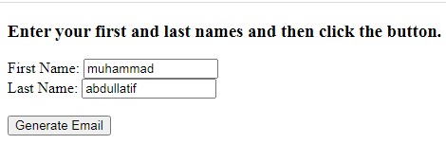
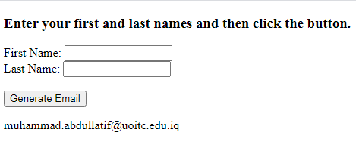
Accessing a Form’s Control Values (continue…)
Outline
Output:
JavaScript Object Properties and HTML Element Attributes
In the form.elements["first"].value code fragment shown in the previous section, the value property returns the text control’s user-entered value. If there’s no user entry, then the value of the text control’s value attribute is returned. If there’s no user entry and there’s also no value attribute, then the value property holds the empty string by default.
Having a corresponding JavaScript value property for the HTML value attribute is indicative of a pattern. There’s a parallel world between JavaScript properties and HTML element attributes. In our earlier presentation of the text control element’s syntax, we showed these text control element attributes:
type, placeholder, size, maxlength, value, autofocus, disabled, readonly
Here are the corresponding JavaScript properties for a text control element object:
type, placeholder, size, maxLength, value, autofocus, disabled, readOnly

Slide 10
Accessing a Form’s Control Values (continue…)
Outline
Note that HTML attributes use all lowercase, whereas JavaScript properties use camel case, which means the two-word properties are spelled maxLength and readOnly.
JavaScript is case sensitive, so you must use camel case for your code to work. HTML is not case sensitive, but you should use all lowercase in order to exhibit proper style.
Control Elements’ innerHTML Property
following p element by replacing its empty content with a generated email address:
<p id="email"></p>
To do that, we retrieve the p element’s object and then use its innerHTML property, like this: document.getElementById("email").innerHTML
The outerHTML property, It accesses the control element’s code, including its start and end tags. The innerHTML property accesses the content within the control element’s code, not including its start and end tags. In generateEmail function, here’s the assignment statement that uses innerHTML to update the p element with a generated email address:
document.getElementById("email").innerHTML =
form.elements["first"].value + "." +
form.elements["last"].value + "@uoitc.edu";
string concatenation operator

Slide 11
reset and focus Methods
Outline
Accessing a Form’s Control Values (continue…)
To connect a string to something else (e.g., another string, a number), you need to use the concatenation operator, +. The resulting connected value forms a string. So in the preceding assignment statement, three concatenation operations form a single string, and that string gets assigned into innerHTML part of retrieved p element.
In the generateEmail function, we use form.elements to retrieve two text controls. form.elements is better to use Because document.getElementById has to search through all the element nodes in the web page’s entire node tree, whereas form.elements has to search through only the control nodes in the form part of the web page’s node tree.
reset and focus Methods
We can see that we still haven’t talked about the last two lines in the generateEmail function. Here are those lines:
form.reset();
form.elements["first"].focus();
The form object’s reset method reassigns the form’s controls to their original values. Because the Email Address Generator web page has no value attributes for its text controls, the reset method call assigns empty strings to the text controls, thereby blanking them out.
When an element object calls the focus method, the browser puts the focus on the element’s control if it’s possible to do so.
For text control elements, like the first-name text control retrieved in the preceding code, putting the focus on it means the browser positions cursor in the text control.

Slide 12
Comments and Coding Conventions
Outline
Comments
JavaScript has two types of comments: one type for short comments and one type for longer comments. The syntax for short comments is simply two forward slashes (//) at the left of the descriptive text. Here’s an example:
// An "admin" user can create and edit accounts.
form.elements["username"].value = "admin";
One of the primary purposes of comments is to explain tricky code so programmers can understand the code more easily.
Some programmers might find the preceding focus method call confusing, and the comment attempts to alleviate some of that confusion.
If you have a comment that spans multiple lines, you can preface each line of the comment with its own //, but that can get cumbersome for long comments. For long comments, you’ll normally want to use the other JavaScript comment syntax. Here’s the syntax for the other type of comment:
/* descriptive-text-goes-here */
This syntax is used for comments that span multiple lines, but it’s legal to use it for single-line comments as well. Here’s an example comment that spans multiple lines:
/* After entering an invalid password 3 times, disable the
password control so the user cannot try again this session.*/
form.elements["password"].readOnly = true;

Slide 13
Comments and Coding Conventions (continue…)
Outline
Code Skeleton That Illustrates Coding Conventions
We should use comments to explain tricky code. In addition, you should include a comment above every function to describe the function’s purpose. To make a function’s preliminary comment and its subsequent function heading stand out, you should insert a blank line between them.
In Figure 6., note the two functions and the comments with blank lines above them. As you read the following coding conventions, for each convention, go to Figure 6., and verify that the code skeleton follows that convention:
If there are two or more functions, separate each adjacent pair of functions with a line of *’s surrounded by blank lines.
Put all variable declarations at the top of a function’s body, and for each variable declaration, provide a comment that describes the variable.
Provide an “end …” comment for each function’s closing brace.
Position a function’s opening brace ({) at the right of the function heading, separated by a space.
Position a function’s closing brace (}) in the same column as the function heading’s first character.
Between a function’s opening and closing braces, indent each statement with two spaces.

Slide 14
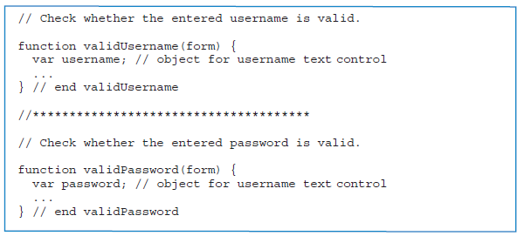
Comments and Coding Conventions (continue…)
Outline
Code Skeleton That Illustrates Coding Conventions (continue…)
Why You Should Use var for Variable Declarations
We should use var to declare the variable in a declaration statement. Unfortunately, many JavaScript programmers do not use var, and you should understand why it’s better to use var.
Using var helps programmers to identify the variables in a function quickly, and that makes the function easier to understand and maintain.
If var is not used for a variable, then the JavaScript engine creates a global variable. A global variable is a variable that’s shared between all the functions for a particular web page.
Figure6. Code skeleton that illustrates coding conventions

Slide 15
Comments and Coding Conventions (continue…)
Outline
Such sharing can be dangerous in that if you coincidentally use same-named variables in different functions, changing the variable’s value in one function affects the variable in the other function.
By using var, you can use same-named variables in different functions, and the JavaScript engine creates separate local variables. A local variable is a variable that can be used only within the function in which it is declared (with var).
The scope of a variable refers to where the variable can be used, so the scope of a function’s local variables is limited to the function’s body. If you have same-named local variables in different functions, changing one of the variables won’t affect the other variable because each variable is a separate entity.
Event-Handler Attributes
The onclick attributeis known as an event-handler attribute because its value is an event handler.
As you know, an event handler is JavaScript code that tells the JavaScript engine what to do when a particular event takes place. When an event takes place, we say that the event fires.
In Figure7., We’ll provide a brief overview of the event-handler attributes and put them to use in web page examples later on.
The first event-handler attribute is onclick. It’s very common to use onclick with a button, but the HTML5 standard indicates that you can use it with any element.

Slide 16
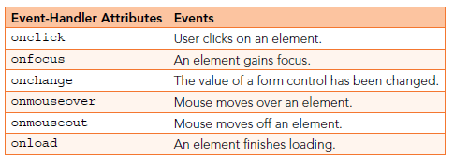
Event-Handler Attributes (continue…)
Outline
The next event-handler attribute is onfocus. You can use onfocus to do something special when a control gains focus.
The next event-handler attribute is onchange. You can use onchange to do something special when a control’s value changes. For example, when the user clicks a radio button, you could implement an onchange event handler that displays an “Are you sure you want to change your selection?” message.
The next event-handler attributes, onmouseover and onmouseout, are often used to implement rollovers for img elements.
The last event-handler attributes is onload. The load event is triggered when the browser finishes loading an element. It’s common to use the onload attribute with the body element so you can do something special after the entire web page loads.
Figure7. Some of the more popular event-handler attributes and their associated events

Slide 17
onchange, onmouseover, onmouseout
Outline
Improving the Email Address Generator Web Page with onchange
In the Email Address Generator web page, suppose you want to force the user to enter the first name before the last name. To do that, you can disable the last-name text control initially and remove that restriction after the first-name text control has been filled in. To determine whether the first-name text control has been filled in, you can rely on the text control’s change event firing.
In implementing the improvements to the Email Address Generator web page, the first step is to disable the last-name text control when the web page first loads. Note the disabled attribute:
Last Name:
<input type="text" id="last" size="15" disabled>
The next step involves adding an onchange event handler to the first-name text control’s input element. Note the onchange event handler:
First Name:
<input type="text" id="first" size="15" autofocus
onchange = "this.form.elements['last'].disabled=false;">
1. Spaces
around = .
2. Retrieve the form object.
3. Retrieve the
last-name text
control object.
4. Make the
control active
(not disabled).

Slide 18
onchange, onmouseover, onmouseout (continue…)
Outline
In our previous event-handler examples, the event handler has always been a function call, like this:
onclick="generateEmail(this.form)";
With a function call, the work is done in the function’s body. In the onchange event handler shown earlier, the event handler contains code that does the work “inline.” Inline JavaScript is appropriate when there is just one statement and there is only one place on the web page where the code is used.
The following four items refer to four noteworthy details from the onchange event handler:-
For the onchange event handler, we have inline JavaScript code and the event handler is not short, so spaces around the = are appropriate.
If you’re inside a form control, to retrieve the form element’s object, use this.form.
To retrieve the last-name text control object, specify elements['last'] with single quotes around 'last' to avoid terminating the prior opening double quote.
To make the retrieved text control active (not disabled), assign false to the text control object’s disabled property.
The onchange event handler activates the last-name text control, and it remains active after that. So, what’s the solution? After clicking the button, you need to disable the last-name text control. To do that, you should add this code at the bottom of the generateEmail function:
form.elements["last"].disabled = true;

Slide 19
onchange, onmouseover, onmouseout (continue…)
Outline
Implementing a Rollover with onmouseover and onmouseout
A rollover is when an image file changes due to the user rolling the mouse over the image.
The Scraps the birthday web page in example 3., If the user moves the mouse over the image, the browser swaps out the original picture and displays a picture of Scraps.
If the mouse moves off of the image, the browser swaps out the picture and displays the original picture.
Example 3., shows the source code for the Scraps web page. With that in mind, this.src refers to the img element’s src attribute, which is in charge of specifying the img element’s image file. So it’s the event handlers’ assignment of files to the src attribute that implements the rollover functionality.
Note the line break in the source code after onmouseover =. The line break is necessary because the event-handler code is long enough to run the risk of bumping against the edge of a printer’s right margin. If that happens, then line wrap occurs.

Slide 20
onchange, onmouseover, onmouseout (continue…)
Outline
Implementing a Rollover with onmouseover and onmouseout (continue…)
Example 3.,
<!DOCTYPE html>
<html lang="en">
<head>
<meta charset="utf-8">
<meta name="author" content="AAA">
<title>Scraps</title>
</head>
<body>
<h1>My Best Friend</h1>
<p>
Move your mouse over the picture to see the birthday scrapbook page.
</p>
<img scr="../images/scrapsAtWork.jpg"
width="130" height="90" alt="Scraps"
onmouseover =
"this.src='../images/scrapsThirdBirthday.jpg';"
onmouseout = "this.src='../images/scrapsAtWork.jpg';">
</body>
</html>
The this keyword refers to the object that contains the script in which this is used. In this example, the enclosing
object is the img element's object.
For statements that are too long to fit on one line, press enter at an appropriate breaking point, and indent.

Slide 21
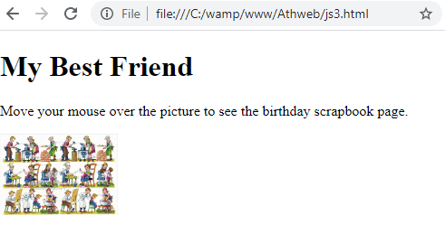
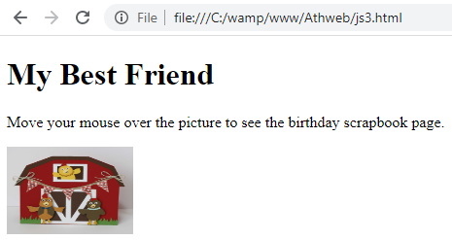
onchange, onmouseover, onmouseout (continue…)
Outline
Implementing a Rollover with onmouseover and onmouseout (continue…)
Example 3., (continue…)
Output:

Slide 22
Using noscript to Accommodate Disabled
JavaScript
Outline
Older browsers don’t support JavaScript, but the bigger roadblock is that some users intentionally disable JavaScript on their browsers. Typically, they do that because they’re concerned that executing JavaScript code can be a security risk. However, most security experts agree that JavaScript is relatively safe. After all, it was/is designed to have limited capabilities.
For example, JavaScript is unable to access a user’s computer in terms of the computer’s files and what’s in the computer’s memory. Also, JavaScript can send requests to web servers only in a constrained (and safe) manner.
Despite JavaScript’s built-in security measures, some users will continue to disable JavaScript on their browsers. For your web pages that use JavaScript, it’s good practice to display a warning message on browsers that have JavaScript disabled. To display such a message on only those browsers and not on browsers that have JavaScript enabled, use the noscript element.
Specifically, add a noscript container to the top of your body container, and insert explanatory text inside the noscript container. Here’s an example:
<noscript>
<p>
This web page uses JavaScript. For proper results,
you must use a web browser with JavaScript enabled.
</p>
</noscript>

Slide 23
Outline
Summary
In this lecture we explained the text control meaning and we highlighted the difference between the text control’s size attribute and its maxlength attribute. The size attribute specifies the text control’s width, whereas the maxlength attribute specifies the maximum number of characters that can be entered in the box.
Also we clarified the email address generator web page with it details.
We explained the meaning of Accessing a Form’s Control Values and examined the function itself and learned how to use the form object to access control values within the form.
Also clarified the focus() and Reset methods, the focus() helps to highlight a HTML form element. It sets the element as an active element in the current document. The reset method sets the values of all elements in a form like clicking the reset button.
Also this lecture highlighted on the Comments and Coding Conventions, that clarified rules for the use of comments and Naming and declaration rules for variables and functions.
This lecture explained briefly the event handler, which was a block of code (usually a JavaScript function that you as a programmer create) that runs when the event fires.
Also We clarified and described the meaning the onmouseout event that occurred when the mouse pointer is moved out of an element, or out of one of its children. And the onmouseout used together with the onmouseover event, which occurred when the pointer was moved onto an element, or onto one of its children.
We explained briefly the noscript tag that defines an alternate content to be displayed to users that have disabled scripts in their browser or have a browser that doesn't support script.

Slide 24


THANK YOU

